Slide 1
Factors Affecting Opioid Treatment
Mohammed Ahmed, Jacob Gibbs, Ethan Nguyen, Erin Starkey

Slide 2
Opioid Use
Drugs
Health Risks
Scope
Heroin
Painful Withdrawal
2 million Americans addicted
Pain Relievers
Overdose
33,000 opioid OD deaths in 2016
Death
Over 50% of all OD deaths are opioids
Drug OD is #1 cause of death under age 50

Slide 3
Project Scope
Question
What factors most affect whether or not an opioid user receives treatment?
Objective
To provide insight on who is not currently receiving the treatment they need and therefore where treatment outreach/support should be focused

Slide 4
Timeline
Data Selection
Dimension Reduction
Analyze Variable Relationships
Predict Outcomes
National Survey on Drug Use and Health
Variable Selection
Define Target Variable
Correlations
Relationship
Visualizations
Regression Modeling of Relevant Variables
Indications of opportunity for better treatment

Slide 5
Data Selection
National Survey on Drug Use and Health, 2017
Statistics on legal and illegal drug use, metal health, and treatment in the United States
Source: Substance Abuse & Mental Health Data Archive
Scale: 2668 variables, 56,276 observations
Both categorical (nominal + ordinal) and numerical (binary + interval)

Slide 6
Dimension Reduction
Target Variable
Has the individual ever received treatment for heroin or pain reliever misuse?
Selected Observations
Only respondents who have ever used heroin or misused pain relievers
Variable Reduction
Removing irrelevant variables or inadvertently duplicated variables

Slide 7
Variables Being Analyzed
Demographics
Age range
Level of education
Gender
Treatment
Methods for paying
Facilities utilized
Usage of heroin or misuse of pain relievers
Frequency
Usage history

Slide 8
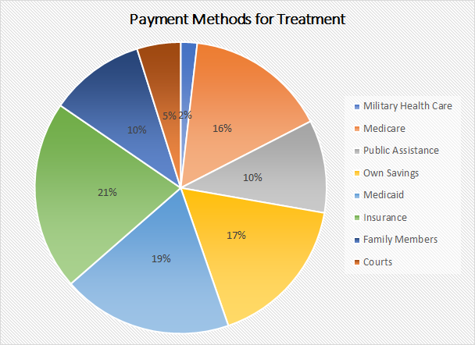
Paying for Treatment
17% of people that reported using opioids in the past 30 days don’t have insurance
Notes:
Could put types of treatment, and then also what percentage of users actually recieve treatment because we are trying to explain that low number

Slide 9
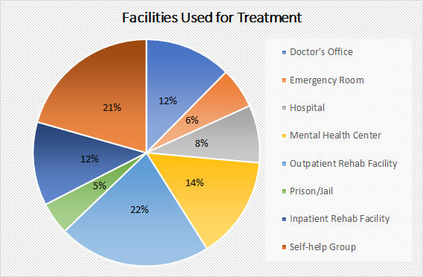
Treatment Facilities

Slide 10
Remaining Work
Complete
Ongoing
Awaiting
Awaiting
Data Selection
Dimension Reduction
Analyze Variable Relationships
Predict Outcomes
Dummy data conversion
Correlation matrices
Run stepwise functions
Finalize model variables
Test model

Slide 11
References
US National Library of Medicine: https://ghr.nlm.nih.gov/condition/opioid-addiction

Slide 12
Comments or Questions?

